Slide 1
Neural Architecture
Search:
DARTS vs Evolution
Giulia Bertazzini
Niccolò Guiducci
Firenze, 25 Gennaio 2023

Slide 2
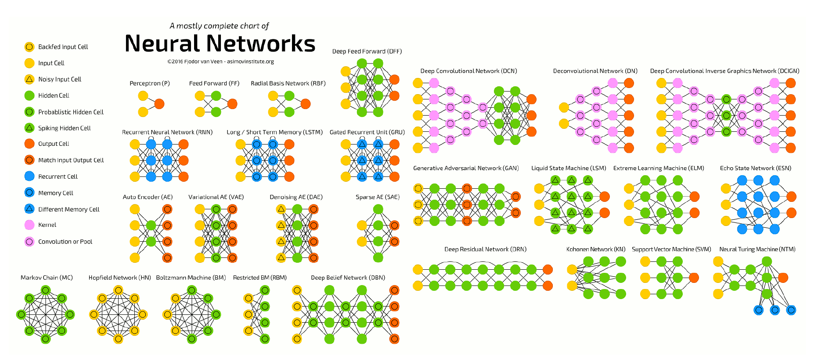
Goals
Reimplement algorithmic solutions to automate the manual process of architecture design
Make a comparison between two different methods for Neural Architecture Search (both applicated to convolutional networks): DARTS and Neuro-Evolution

Slide 3
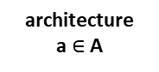
Introduction
Due to a rising demand for architecture design, more complex NAs are designed manually by human experts → time-consuming and error-prone process.
The idea behind this field is to explore how can we automatically search deep learning model architectures.
NAS methods have outperformed manually designed architectures on some tasks (i.e. image classification and object detection).
architecture
a $∈$A
Search Space
A
Search Strategy
Perfomance Estimation Strategy
performance
estimate of a

Slide 4
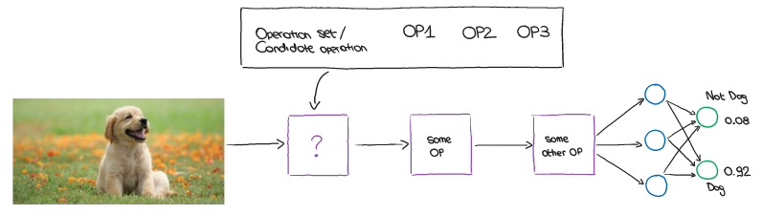
Introduction
The problem of neural architecture search is posed as follows:
Given a set of search space operation O, we need to find the combination of these operations that maximizes or minimizes the objective function.
Need to find the architecture of the model to minimize the loss (or maximize the accuracy).

Slide 5



Implementation
Since the main goal is to make a comparison between DARTS and neuro-evolution approaches, a common structure for the architecture has been developed.
The approaches mainly differ in the search strategy.
Both methods search the best architecture of a convolutional network for a task of image classification.
Main implementation tools:
Python;
PyTorch framework;
Deep Graph Library (DGL).

Slide 6
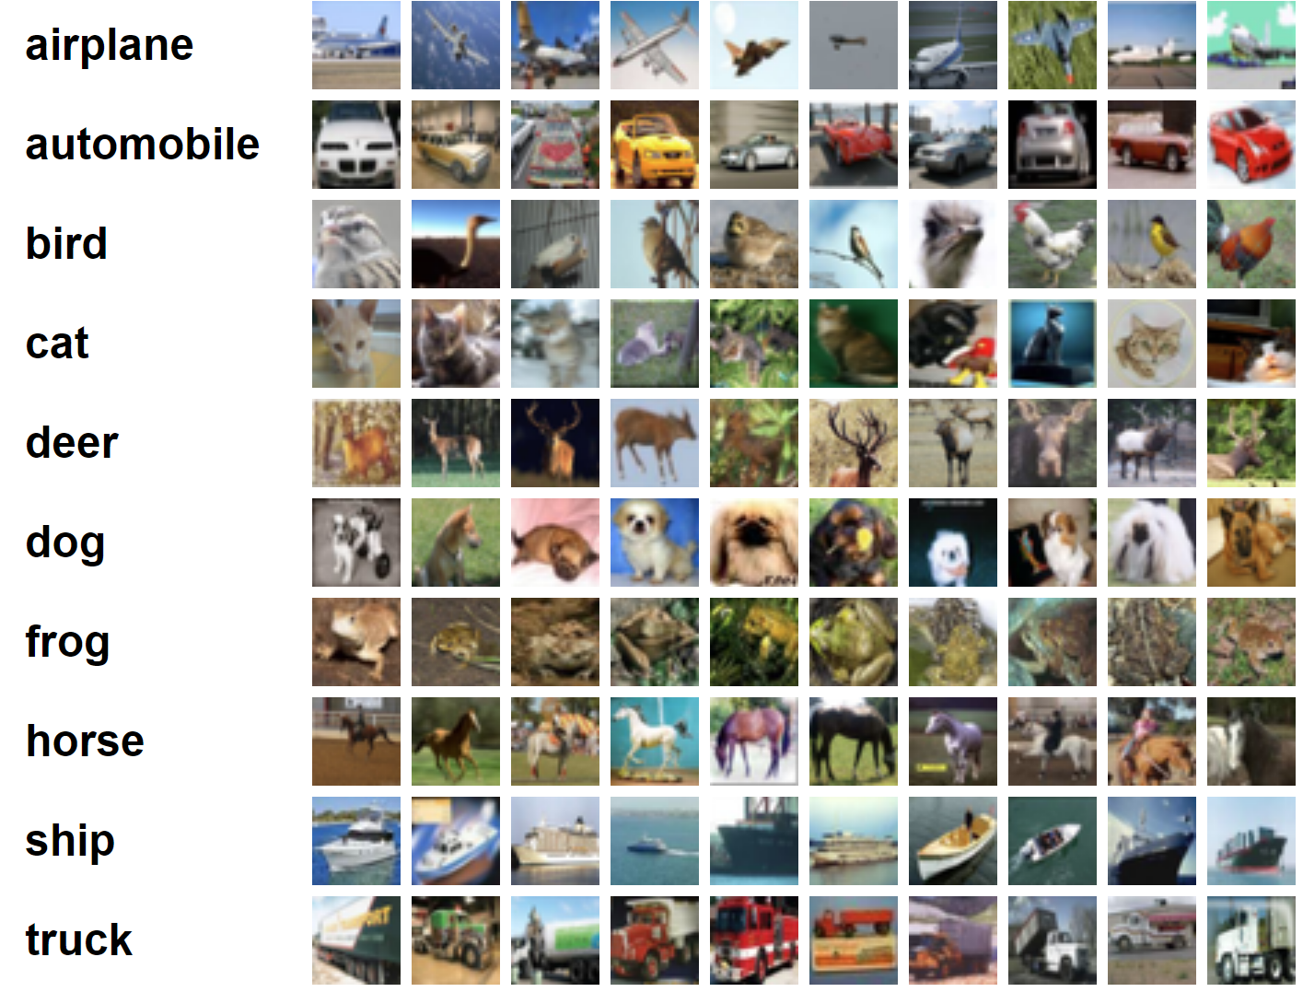
Implementation – Dataset
CIFAR-10 dataset:
60 000 32x32 RGB images in 10 classes, with 6 000 images per class;
50 000 training images;
10 000 test images.

Slide 7
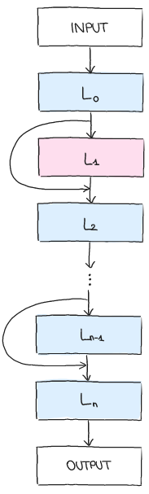
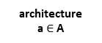
Implementation – Search Space
architecture
a $∈$A
Search Space
A
Search Strategy
Perfomance Estimation Strategy
performance
estimate of a
defines which architectures might be discover by a NAS approach;
a chain-structured neural networks;
parametrized by number of layers (n), the type of operation every layer executes and hyperparameters associated with the operation;
search cells rather than the whole architecture;
major advantages: search space dimension drastically reduced, architecture can be easily transferred or adapted to other datasets and useful design principle in general.

Slide 8
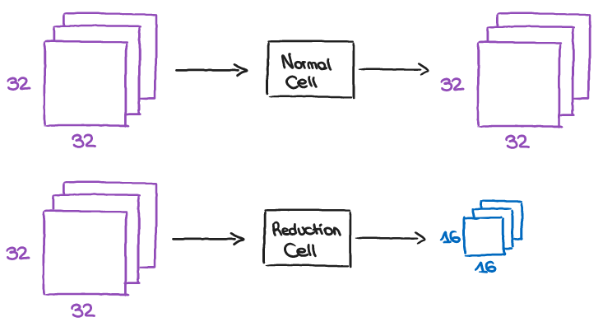
Implementation – Search Space
Cell:
special block where layers are stacked just like any other model;
apply operations to get feature maps, which can be passed over to other cells.
Model:
made by stacking these cells in a series to make a complete model.
Two different kind of cells:
Normal Cell, which preserve the dimensionality of the input;
Reduction Cell, which reduce the spatial dimension (located at the 1/3 and 2/3 of the depth of the network).

Slide 9
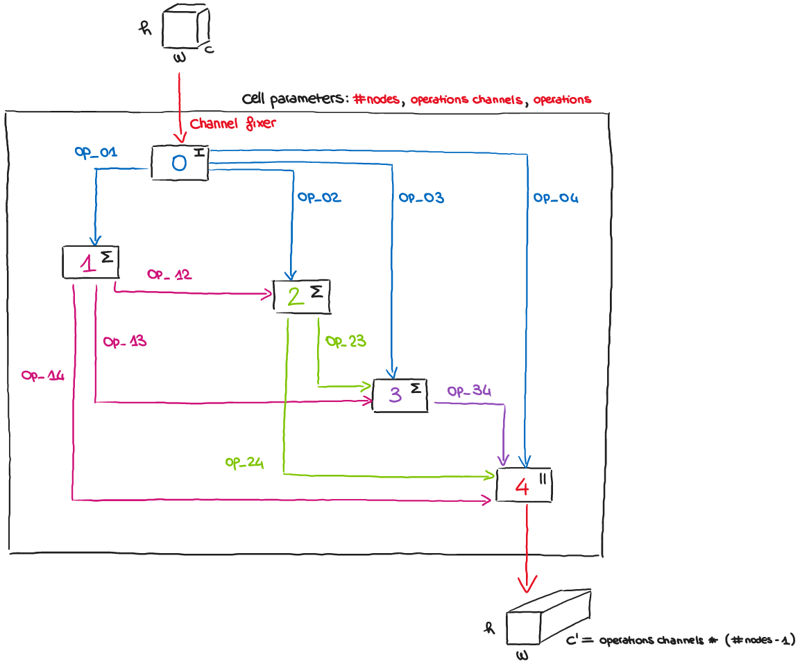
Implementation – Search Space
Cell Structure

Slide 10
Implementation – Search Space
Type of operations
Convolution (torch.nn.Conv2d)
Max pooling (torch.nn.MaxPool2d)
Average pooling (torch.nn.AvgPool2d)
Identity
Zero operation (indicates a lack of connection between two nodes)
In a normal cell, all operations are of stride 1 (if applicable) and the convolved feature map are padded to preserve their spatial resolution;
in a reduction cell all the operations adjacent to the input node are of stride 2, to reduce the spatial resolution.
Convolution and pooling operation have the additional parameter «kernel size» (3 or 5).

Slide 11
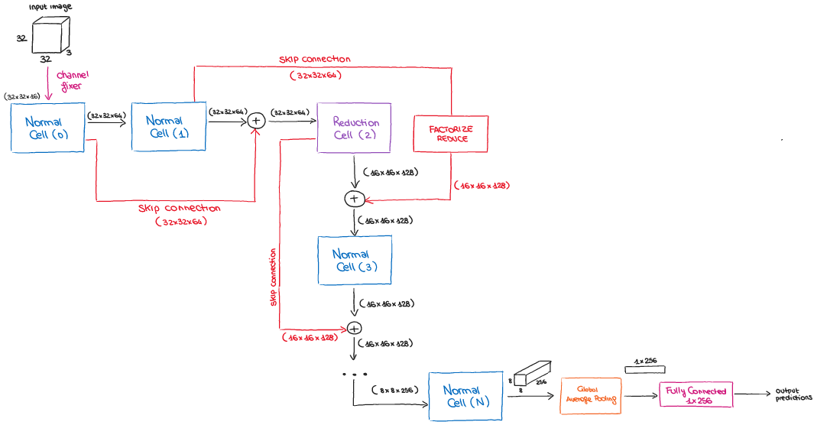
Implementation – Search Space
Network Structure
final architecture built by stacking cells

Slide 12
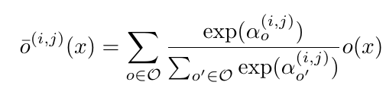
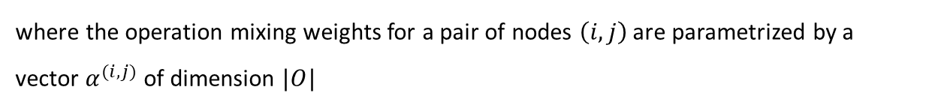
Implementation – Search Strategy
DARTS
architecture
a $∈$A
Search Space
A
Search Strategy
Perfomance Estimation Strategy
performance
estimate of a
Instead of searching over a discrete set of candidate architectures, the idea is to relax the search space to be continuous → architecture can be optimized with respect to its validation set by gradient descent.
To do this, authors relax the categorical choice of a particular operation to a softmax over all possible operations:
where the operation mixing weights for a pair of nodes $\left(i,j\right)$ are parametrized by a vector $α^{(i,j)}$ of dimension $|O|$

Slide 13
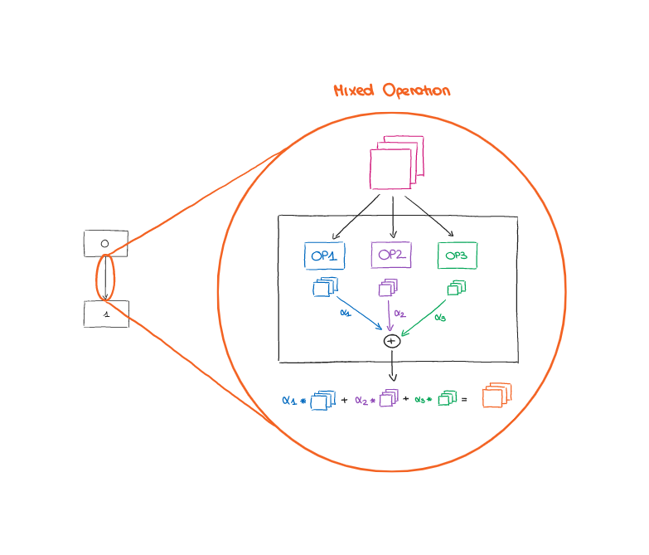
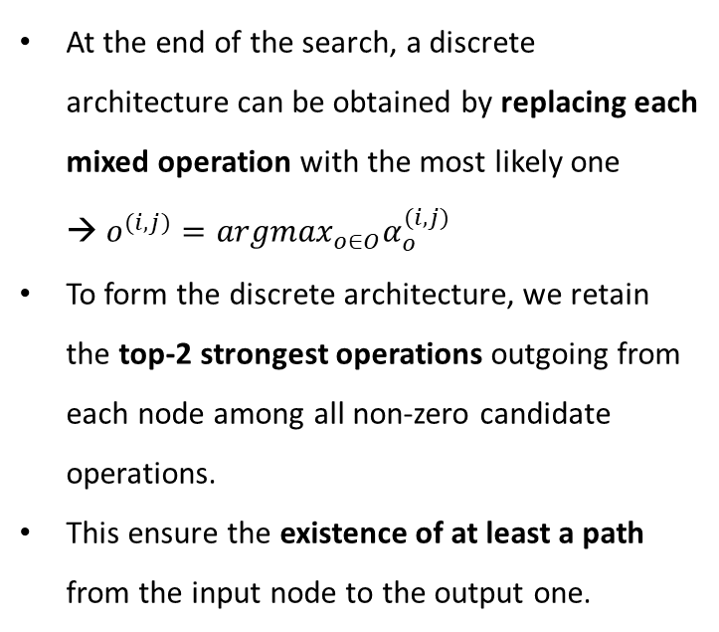
Implementation – Search Strategy
DARTS
At the end of the search, a discrete architecture can be obtained by replacing each mixed operation with the most likely one → $o^{(i,j)}={argmax}_{o∈O}α_{o}^{(i,j)}$
To form the discrete architecture, we retain the top-2 strongest operations outgoing from each node among all non-zero candidate operations.
This ensure the existence of at least a path from the input node to the output one.

Slide 14
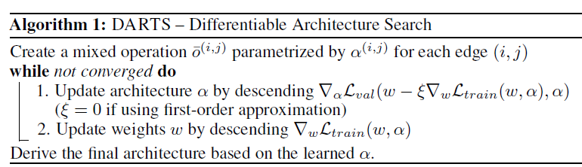
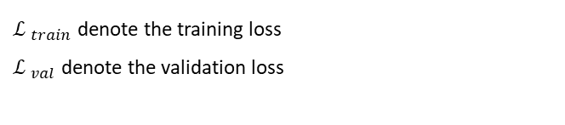
Implementation – Search Strategy
DARTS
The goal is to jointly learn the architecture α and the weights w within all the mixed operations (e.g. weights of the convolution filters).
The optimization problem can be posed as to finding alphas so that validation loss is minimized given that we have weights that are already optimized on the training set.
The idea is to approximate the optimized weights by adapting w using only a single training step, without solving the inner optimization completely by training until convergence
${ℒ }_{train}$ denote the training loss
${ℒ }_{val}$ denote the validation loss

Slide 15
Implementation – Search Strategy
Neuro-evolution method
In tasks where there is no gradient available in the search space, instead of gradient descent, evolution is used to optimize the architecture.
Generally, evolutionary algorithms evolve a population of models (i.e., a set of possibly trained networks);
Genetic algorithms are a natural choice that are inspired by Charles Darwin’s theory of natural evolution; reflect the process of natural selection.
In every evolution step, at least one model from the population generate offsprings by applying mutations or crossover (local operations for NAS).
Neuro-evolutionary methods differ in how they sample parents, update populations, and generate offsprings.

Slide 16
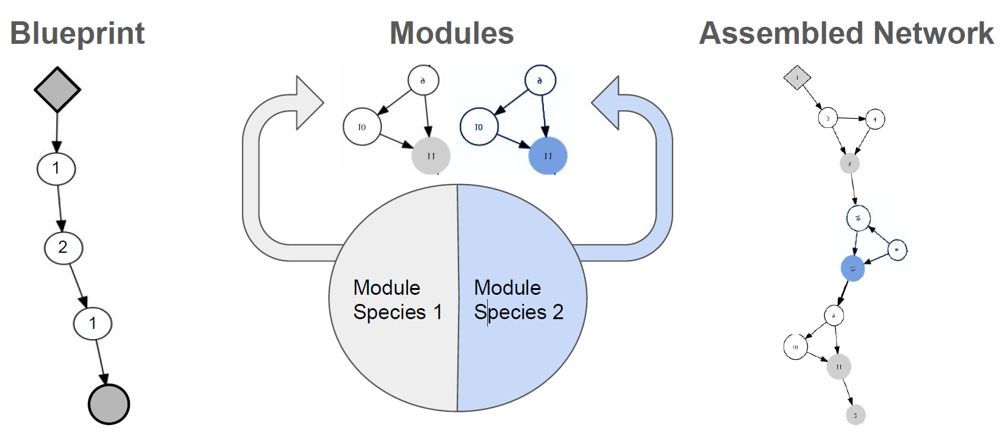
Implementation – Search Strategy
CoDeepNEAT
Unlike traditional neuro-evolution algorithms, CoDeepNEAT algorithm not operate on and evolve genomes directly, but instead primarily operates on blueprints and modules.
NN architecture as a graph:
each node represents a layer in a DNN;
each node contains a table of hyperparameters that determine the type and properties of a layer;
the edges indicate how the nodes (layers) are connected together.

Slide 17
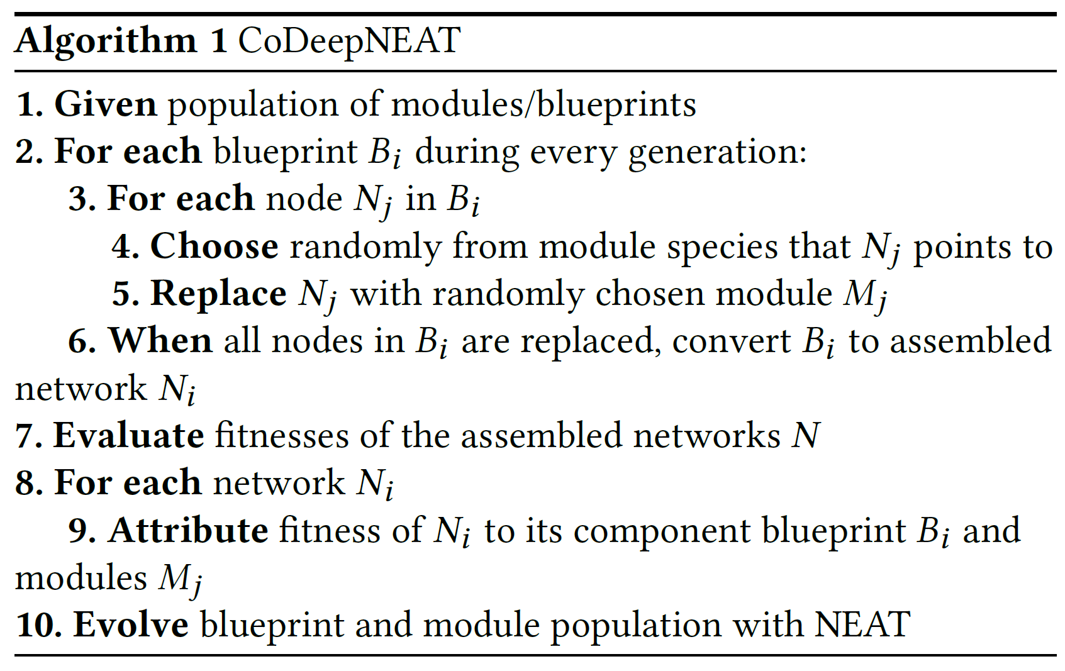
Implementation – Search Strategy
CoDeepNEAT Algorithm
Population initialization: modules and blueprints initialized with random parameters.
Evaluation: population is evaluated by assembling genomes blueprints and modules, updating the fitness value (as average fitness) after all genomes of the generation have been generated and evaluated.
Evolution: first, selects species and members of the population that fit enough to create offsprings, erasing the rest of population; then parental members of the generation are mutated and crossed over to create offsprings; at the end of evolution of a generation there is the speciation of the population

Slide 18
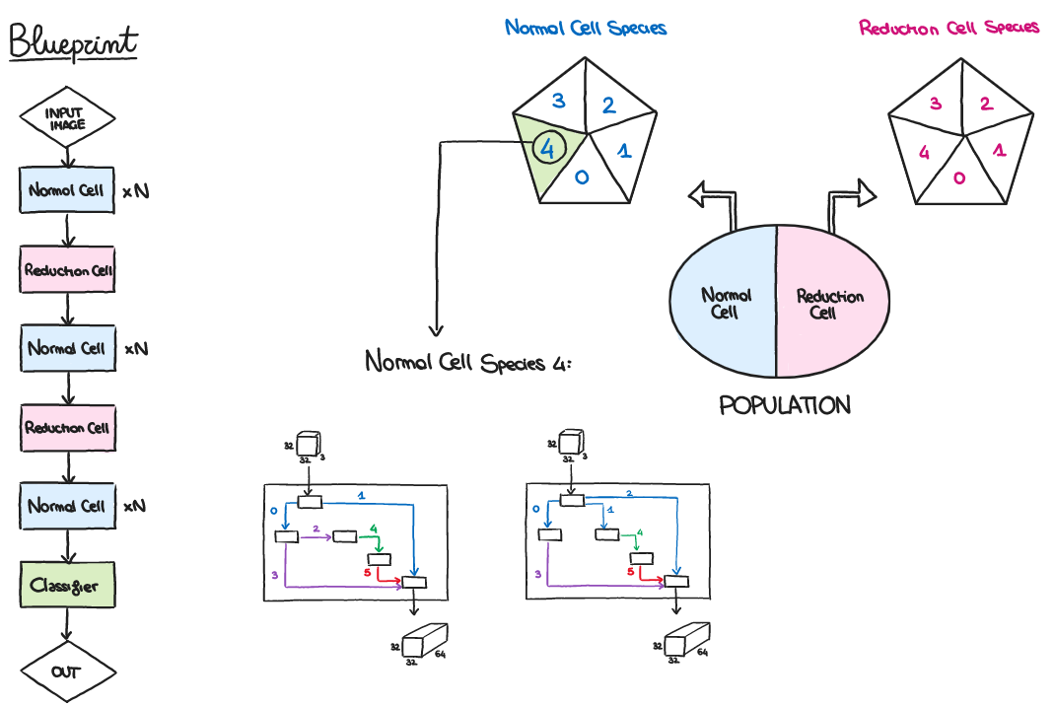
Implementation – Search Strategy

Slide 19
Implementation – Search Strategy
Population initialization: generation of the first 6 species with 3 random individuals for each.
Evaluation: as CoDeepNEAT; in particular, the species’ fitness is calculated as the average fitness of the species alive individuals.
Evolution:
Selection: for each species, we remove the worst 2 individuals, which can have or have not the same chromosome; this process can lead to the species’ extinction. We select the couples of best individuals.
Reproduction: each species generates a number of offsprings proportional to its fitness (from 1 to 4 offspring), through a stochastic 50-50 crossover; for each new offspring there is a mutation probability. If there is only one individual in the species, mutation is applied to generate new offspring.
Speciation: each offspring is assigned to the corresponding species (determinated by the number of zero operations).

Slide 20
Implementation – Performance Estimation Strategy
architecture
a $∈$A
Search Space
A
Search Strategy
Perfomance Estimation Strategy
performance
estimate of a
To find A that maximize some performance measure, the simplest way is to train A on a training dataset and evaluate its performance on validation dataset → high computational cost.
Methods for speeding up have been developed, such as basing performance estimation on lower fidelities of the actual performance after full training (training for fewer epochs, on a subset of the data, with less filters per layer, less cells, and so on).

Slide 21
Experiments and Results
Executed on computer with the following specifics:
OS: Microsoft Windows 10 Pro
CPU: 11° Gen Intel(R) Core(TM) i9-11900KF @3.5GHz(TBoost 5.1GHz) Octa-Core
GPU: GeForce RTX 3070Ti
RAM: 32GB DDR4 @3600 MHz
MOBO: Asus PRIME Z490-A

Slide 22
Experiments and Results
DARTS configuration – Architecture Search
Dataset: entire training dataset of CIFAR-10, split in half between weights and alpha optimization.
Architecture parameters:
9 cells consist of 5 nodes;
initial number of channels 16.
Training parameters:
Epochs: 60
Batch size: 64
Learning rate: 0.025 (weights) and 3x10⁻⁴ (alphas)
Scheduler: CosineAnnealingLR without restart
Optimizer: AdamW
Criterion: CrossEntropyLoss

Slide 23
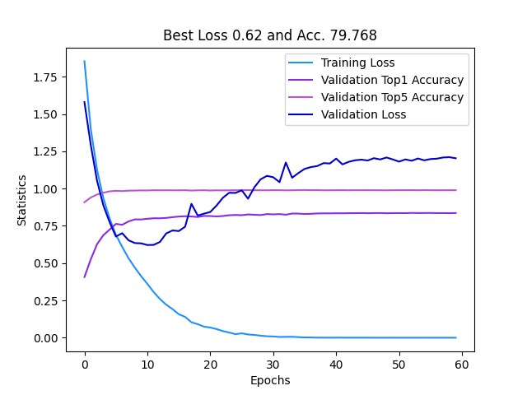
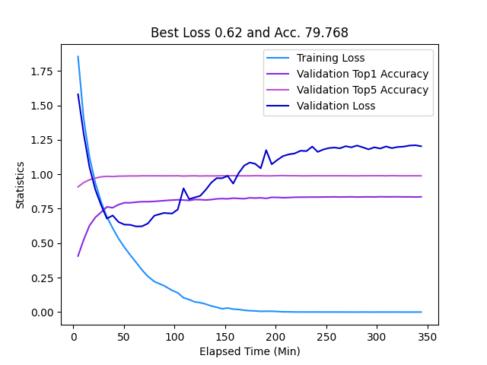
Experiments and Results
DARTS results – Cell Search
Results for cell training throughout epochs and elapsed time (in minutes)
Training based on loss: best loss obtained 0.62 (with corresponding accuracy 79.768%)
Required search time ≈ 6 hours (best cell found ≈ 1 hour)

Slide 24
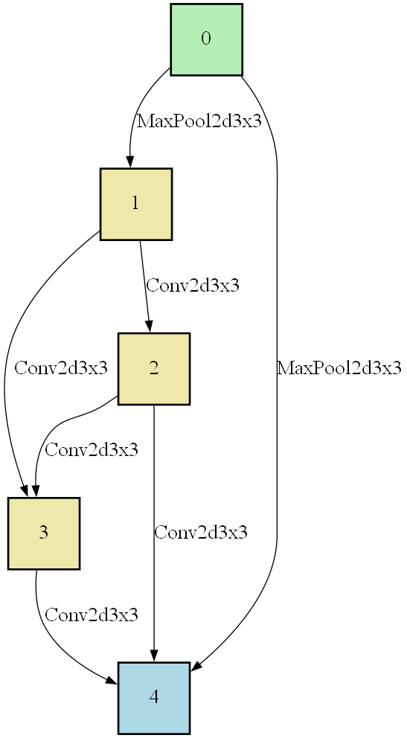
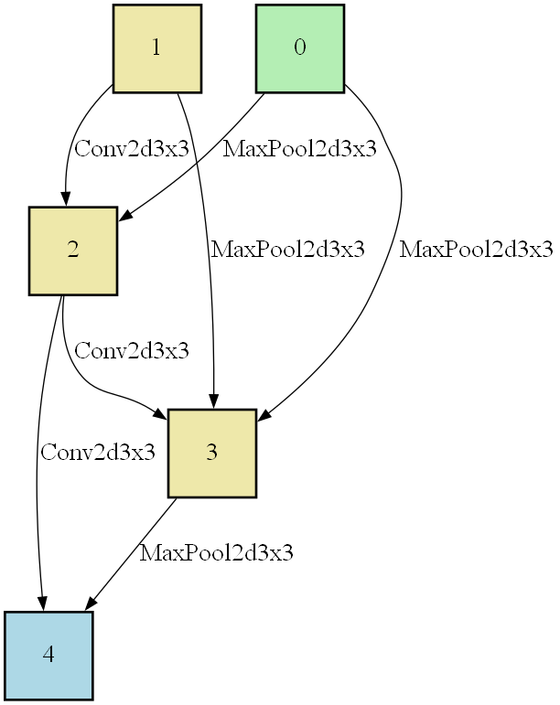
Experiments and Results
DARTS results – Cell Search
At the end of the search
BEST NORMAL CELL
BEST REDUCTION CELL

Slide 25
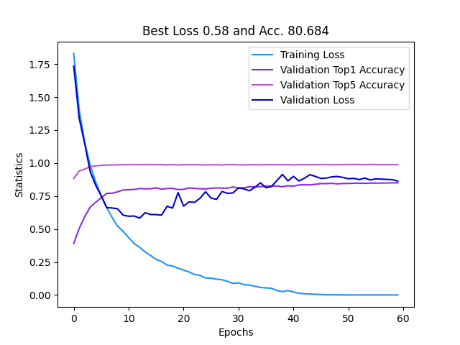
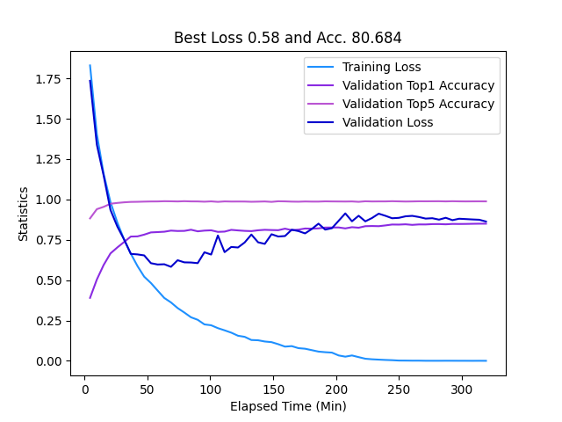
Experiments and Results
DARTS results – Network Search
Results for network training throughout epochs and elapsed time (in minutes)
Training based on loss: best loss obtained 0.58 (with corresponding accuracy 80.684%)
Required search time ≈ 5 hours (best network found ≈ 1 hour)

Slide 26
Experiments and Results
DARTS configuration – Architecture Evaluation
Dataset: entire dataset of CIFAR-10 (divided in training and test)
Architecture parameters:
23 cells consist of 5 nodes (network built stacking the best normal cell and the best reduction cell find at the end of architecture search)
initial number of channels increased to 36.
Training parameters: same as architecture search, except for the batch size which is increased to 96.

Slide 27
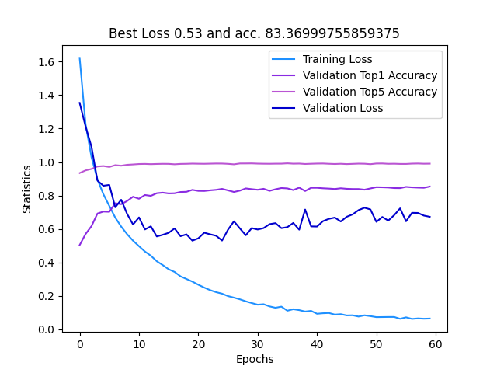
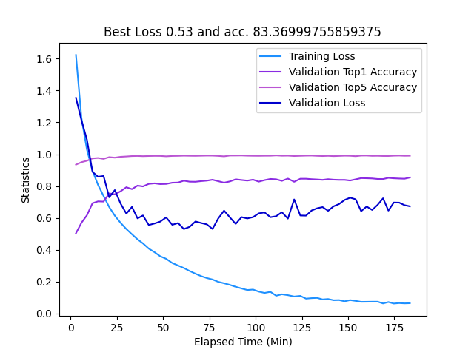
Experiments and Results
DARTS results – Cell Evaluation
Training Loss
Test Top1 Accuracy
Test Top5 Accuracy
Test Loss
Training Loss
Test Top1 Accuracy
Test Top5 Accuracy
Test Loss
Results for cell evaluation throughout epochs and elapsed time (in minutes)
Training based on loss: best loss obtained 0.53 (with corresponding accuracy 83.367%)

Slide 28
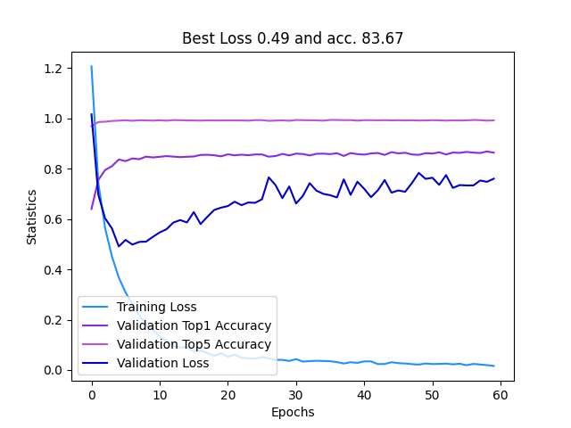
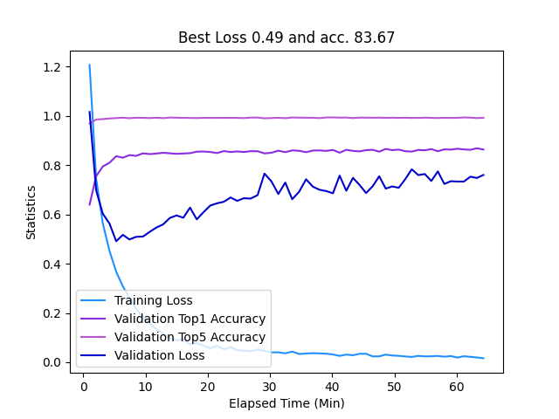
Experiments and Results
DARTS results – Network NoConcat Evaluation
Results for network evaluation (NO concatenation) throughout epochs and elapsed time (in minutes)
Training based on loss: best loss obtained 0.49 (with corresponding accuracy 83.67%)

Slide 29
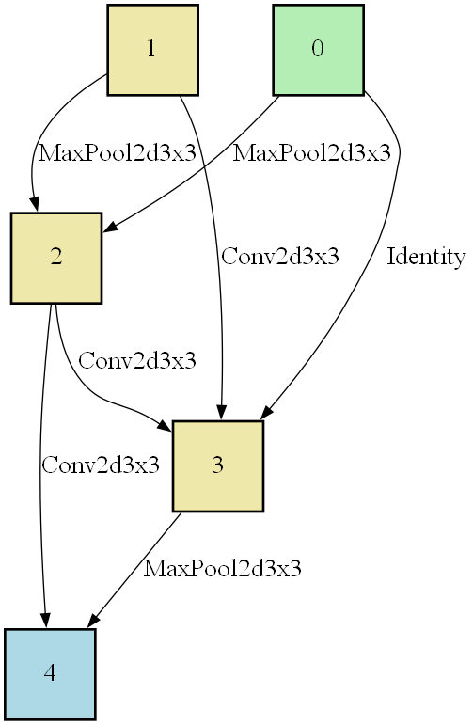
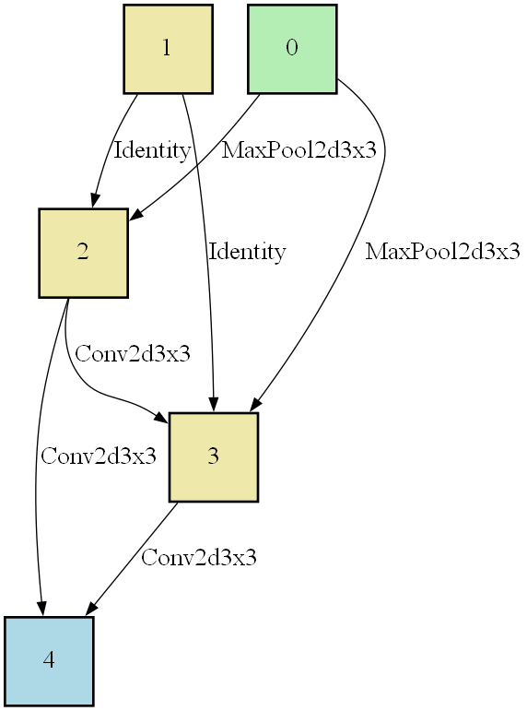
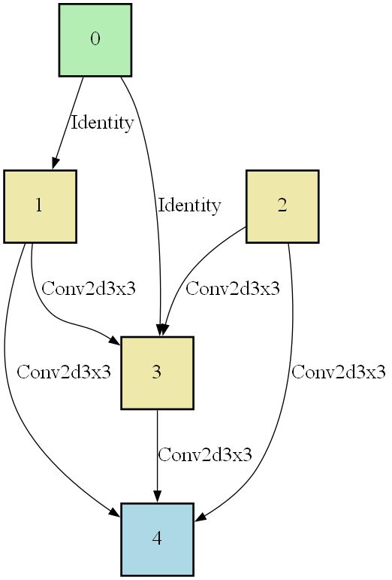
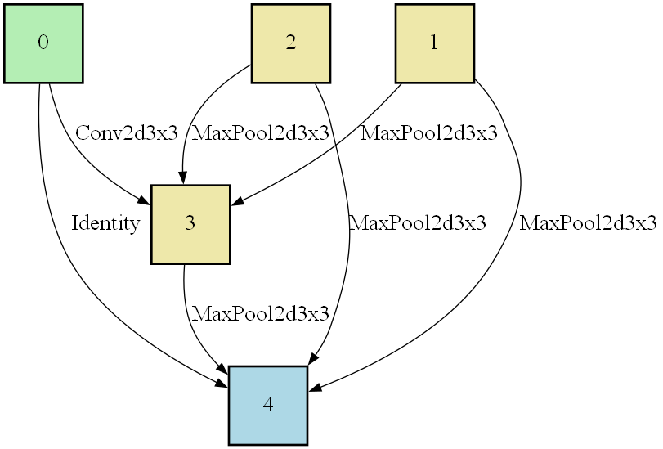
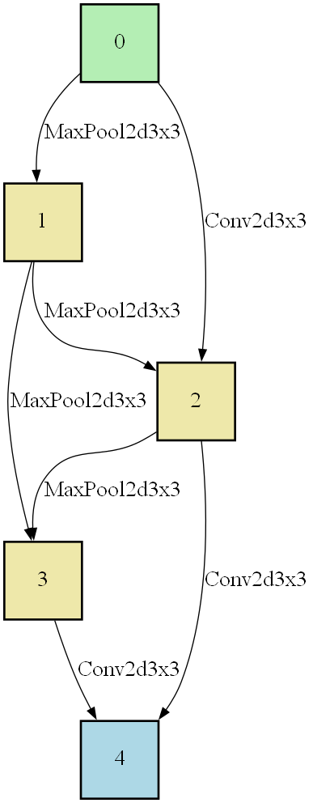
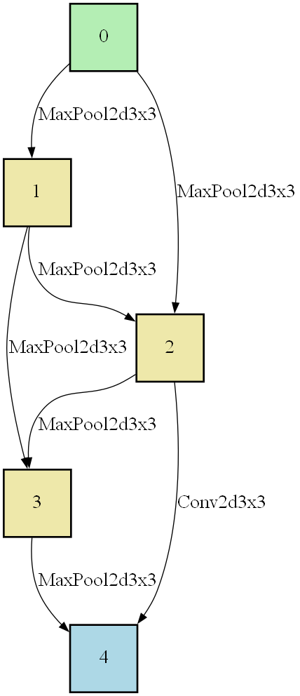
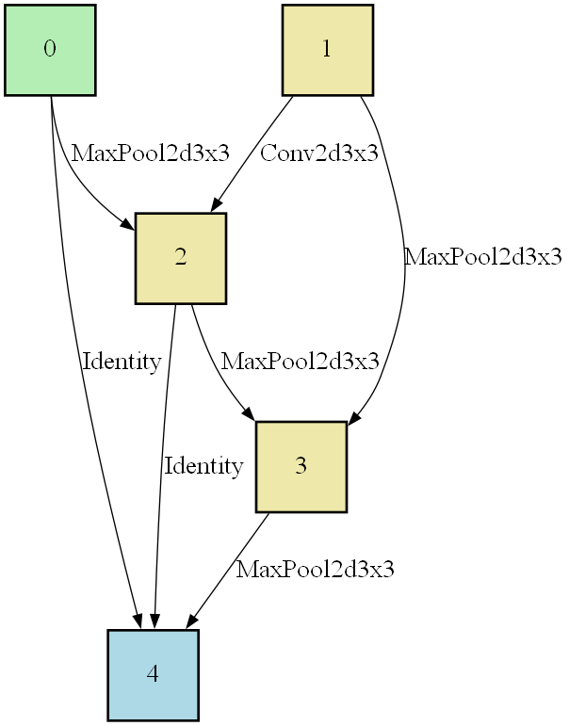
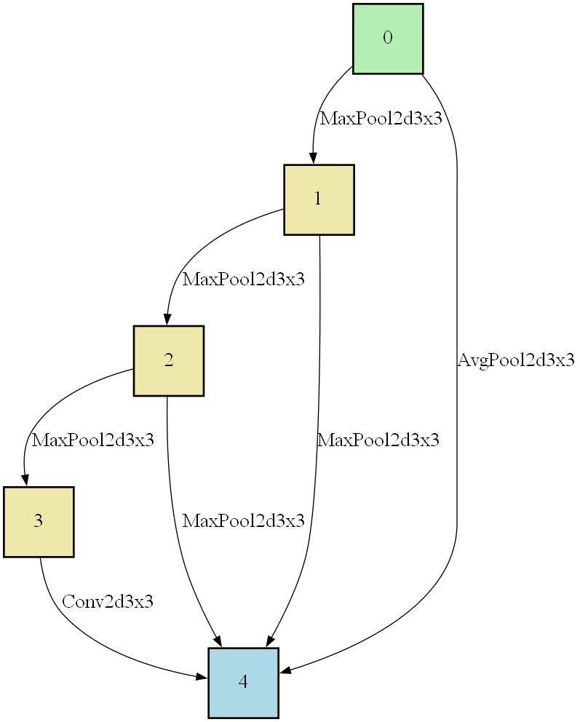
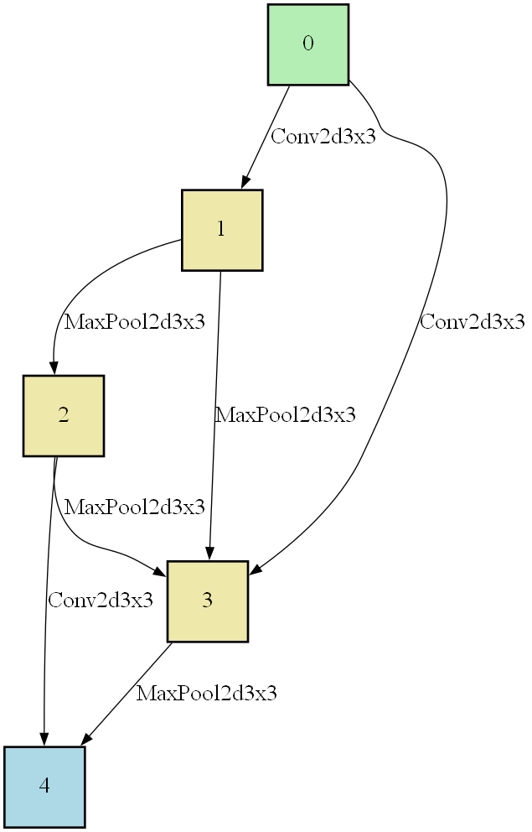
Experiments and Results
Normal cell
Reduction cell
DARTS results – Network NoConcat Evaluation

Slide 30
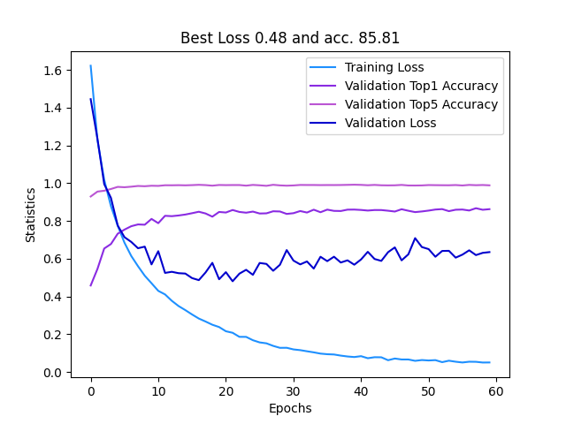
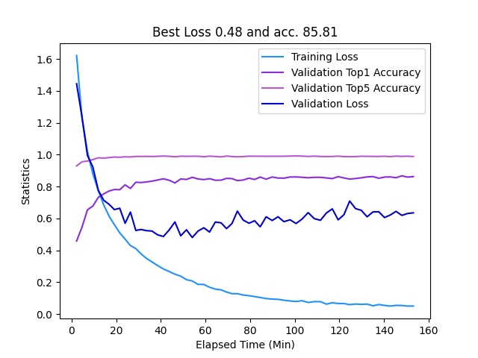
Experiments and Results
DARTS results – Network Concat Evaluation
Training Loss
Test Top1 Accuracy
Test Top5 Accuracy
Test Loss
Training Loss
Test Top1 Accuracy
Test Top5 Accuracy
Test Loss
Results for network evaluation (with concatenation) throughout epochs and elapsed time (in minutes)
Training based on loss: best loss obtained 0.48 (with corresponding accuracy 85.81%)

Slide 31
Experiments and Results
Neuro-evolution configuration – Architecture Search
Architecture parameters: a single blueprint with 9 cells consist of 5 nodes; initial number of channels 16.
Evolution parameters:
Generations: 72
Initial population: 6 species for each subpopulation, with 3 individuals
Number of offspring: 1-4 (based on fitness) for each species
Mutation rate: 20% and maximum mutation rate: 30%
Number of “kills”: 2 individuals for each species
Species selection follows an exponential distribution
Decisions based on accuracy (fitness mode)
Network number: 20
Dataset: 30% training dataset of CIFAR-10
Training parameters: epochs: 8, batch size: 256, learning rate: 1x10⁻³, optimizer: AdamW, criterion: CrossEntropyLoss

Slide 32
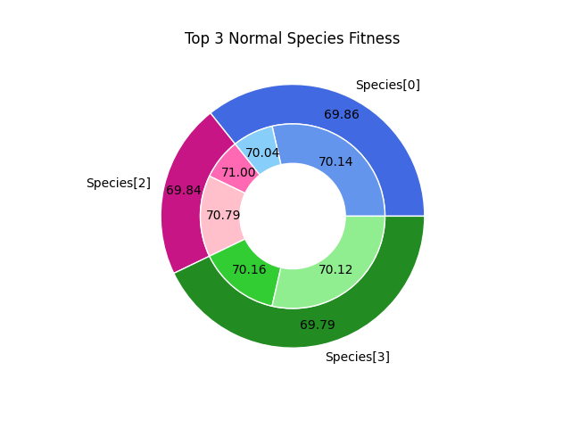
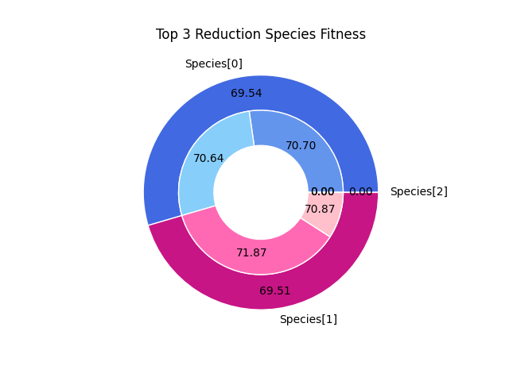
Experiments and Results
Top 1 Species
Top 2 Species
Top 3 Species
Neuro-evolution results – Cell Search
Results for cell search (normal and reduction)
Training based on accuracy
Required search time for cell search in 72 generations ≈ 24 hours

Slide 33
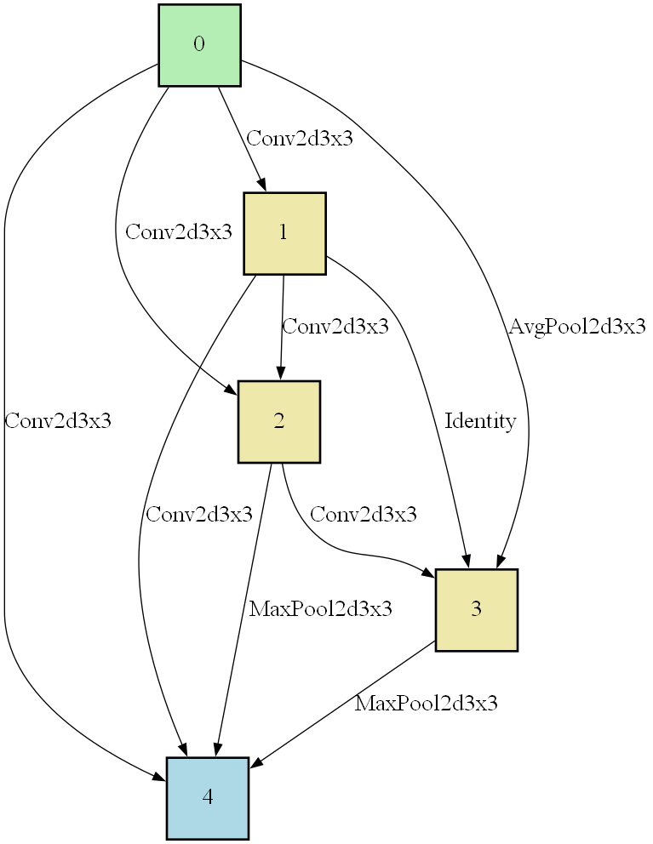
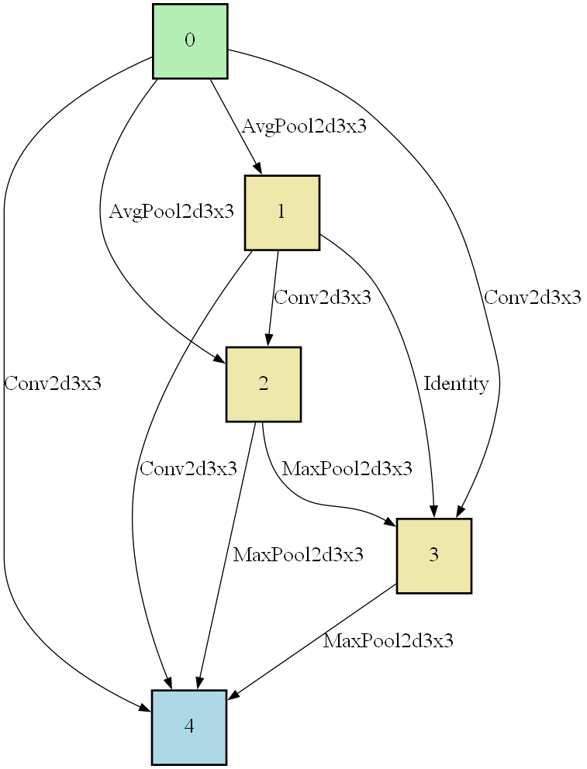
Experiments and Results
Neuro-evolution results – Cell Search
At the end of the search
BEST NORMAL CELL
BEST REDUCTION CELL

Slide 34
Experiments and Results
Neuro-evolution configuration – Architecture Evaluation
Dataset: entire dataset of CIFAR-10 (divided in training and test)
Architecture parameters:
23 cells consist of 5 nodes (network built stacking the best normal cell and the best reduction cell find at the end of architecture search)
initial number of channels increased to 36.
Training parameters: same as architecture search, except for the epochs (60) and the batch size which is decreased to 96.

Slide 35
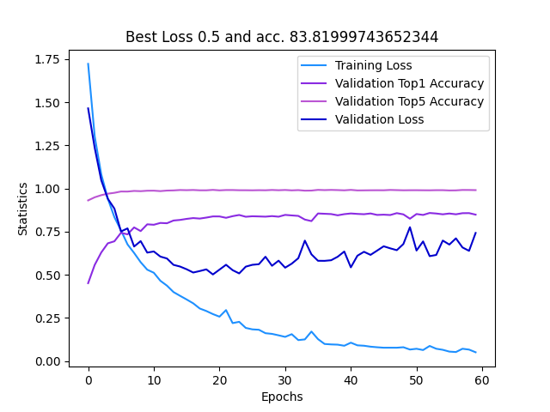
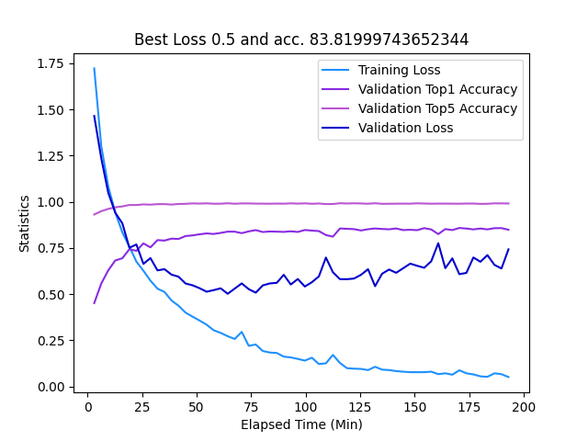
Experiments and Results
Neuro-evolution results – Cell Evaluation
Training Loss
Test Top1 Accuracy
Test Top5 Accuracy
Test Loss
Training Loss
Test Top1 Accuracy
Test Top5 Accuracy
Test Loss
Results for cell evaluation throughout epochs and elapsed time (in minutes)
Training based on loss: best loss obtained 0.5 (with corresponding accuracy 83.81%)

Slide 36
Conclusions
 | DARTS (CELL) | DARTS (NETWORK) | CODEEPNEAT NEURO-EVOLUTION | GENETIC NEURO-EVOLUTION
Search Time | ≈ 1-6 hours | ≈ 1-6 hours | ≈ 24 hours | ≈ 52 hours
Evaluation Accuracy | 83.37% | 85.81% | 83.81% | 86.14%
Evaluation Loss | 0.53 | 0.48 | 0.5 | 0.42
The architecture obtained after a DARTS network search has achieved the best results, in terms of required search time and performances.
As expected, DARTS reduces a lot the search cost, manteining or increasing the results achieved with a neuro-evolution approach.

Slide 37
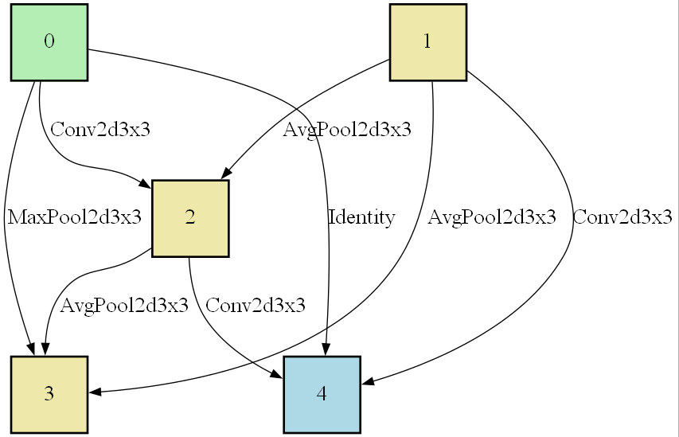
Conclusions
DARTS VS CoDeepNEAT – Normal Cell
Top individual of the top species
Top individual of the subpopulation
DARTS normal cell
CoDeepNEAT normal cell

Slide 38
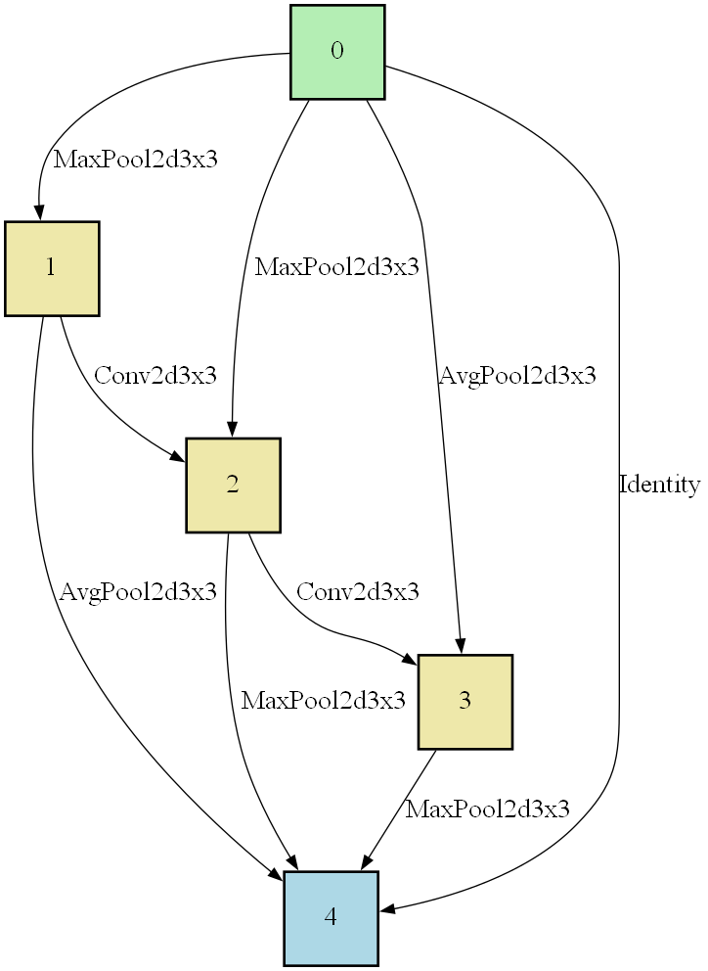
Conclusions
DARTS reduction cell
CoDeepNEAT reduction cell
DARTS VS CoDeepNEAT – Reduction Cell
Top individual of the subpopulation
Top individual of the top species

Slide 39
Conclusions
DARTS Cell VS DARTS Network – Normal Cells
DARTS Cell
DARTS Network

Slide 40
Neural Architecture
Search:
DARTS vs Evolution
Giulia Bertazzini
Niccolò Guiducci
Firenze, 25 Gennaio 2023

